Slide 1



From Standards to Excellence: Advancing Quality at UM6P
Quality Assurance at UM6P
Our Shared Commitment to Excellence
Academic Quality Office
13 Décembre 2025

Slide 2
Outline :
Welcome
Academic Quality Team, Vision, Missions
Academic Quality Office Initiatives
Quality Assurance Framework at UM6P
Conclusion
Notes:
Here is the outline of my presentation. I will begin with a brief introduction, then present UM6P’s vision and mission to set the context. After that, we’ll explore global trends in quality assurance in higher education, followed by an overview of Morocco’s national QA framework, the ANEAQ model. I will then describe the internal Quality Assurance Framework we’ve developed at UM6P, and finally, I will share some of our key QA projects, including ABET, EAQUALS, AACSB, and ISO 21001 initiatives. I will close with a few concluding remarks on our strategic approach to quality.”

Slide 3
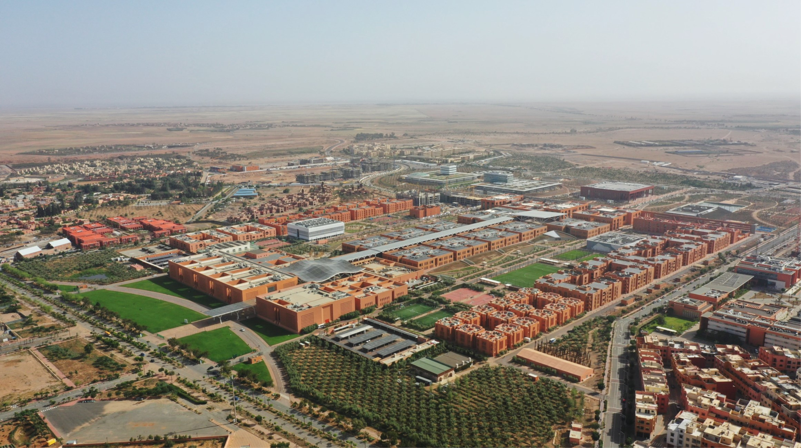
University Mohammed VI Polytechnic
Notes:
Let me start with a quick overview of Mohammed VI Polytechnic University
This will help situate our approach to quality assurance within the broader mission and identity of our institution

Slide 4

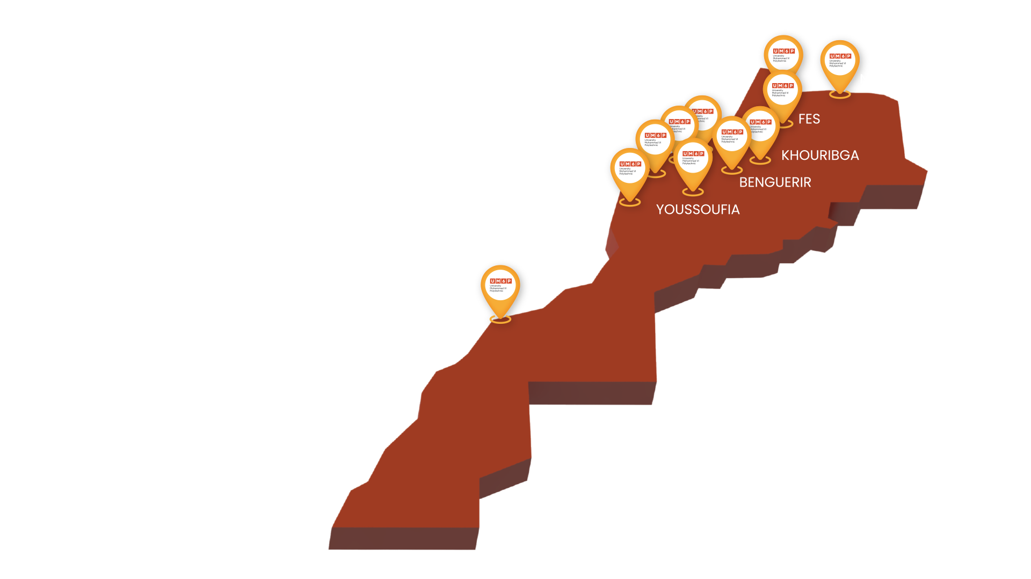
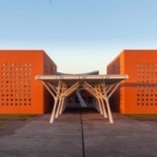
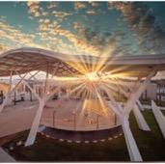
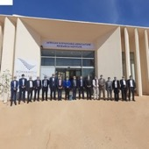
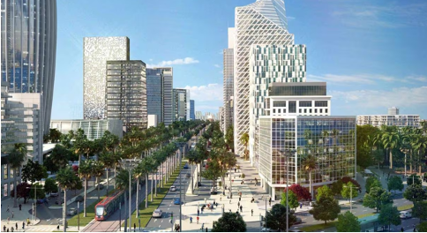
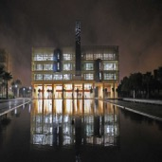
Thematic sites to respond to territorial challenges
BENGUERIR
The UM6P Central Campus dedicated to applied research and the teaching of exact sciences.
RABAT
Rabat hosts UM6P Faculty of Governance, Economics and Social Sciences, in addition to Ai Research Center and Africa Business School.
LAAYOUNE
In Laayoune, ASARI "African Sustainable Agriculture Research Institute" is the first component of UM6P Campus, to tackle the agricultural challenges of Morocco and Africa.
CASABLANCA /
NOUACEUR
To ensure proximity to the business world, UM6P will soon settle a platform of innovation and a Startup ecosystem in Casablanca. Additionally, an aeronautic research ecosystem is being developed in Nouaceur.
KHOURIBGA / TETOUANE / YOUSSOUFIA / SAFI / NADOR / FES
The 1337 and YouCode schools specialized in computer coding have opened in several cities. In Tetouane, in collaboration with the F.TMSA.
Notes:
Beyond its central campus, UM6P has developed a strong territorial presence across Morocco.
Each site plays a specific role in addressing local and regional challenges — reflecting our mission of impact and innovatio

Slide 5
DIVISIONS & SCHOOLS
Science & Technology Division
Health Division
Humanities, Economics
& Social Sciences Division
Business & Management
Division
EMINES
School
of Industrial Management
CSAES
College of Sustainable Agriculture & Environmental Sciences
CC
College of
Computing
UM6P-FMS
Faculty of Medical Sciences
FGSES
Faculty of Governance, Economics and Social Sciences
ABS
Africa Business School
Ai Movement
SAP+D
School of Architecture, Planning and Design
College of Chemical Sciences & Engineering
SHBM
School of Hospitality Business & Management
SCI
School of Collective Intelligence
GTI
Green Tech Institute
MASCIR
SASE
School of Applied Sciences & Engineering
PPS
Public Policy School
Story School
S&T Executive Education
CEDOC - Center for Doctoral Studies
Notes:
UM6P is organized into four main academic divisions:
The Science and Technology Division, which includes schools such as EMINES, the College of Computing, and the Green Tech Institute.
The Health Division, represented by the Faculty of Medical Sciences.
The Humanities, Economics and Social Sciences Division, which includes the Faculty of Governance and the Public Policy School.
And finally, the Business and Management Division, with Africa Business School, the School of Collective Intelligence, and the Story School.

Slide 6


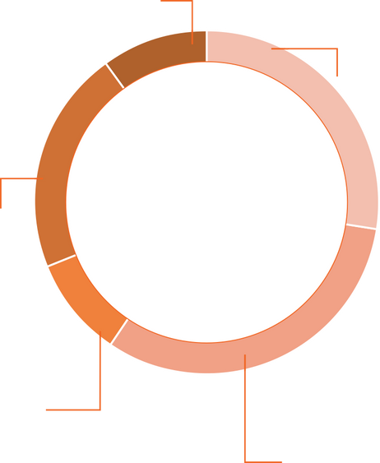
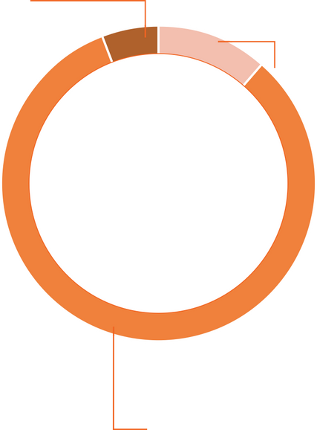
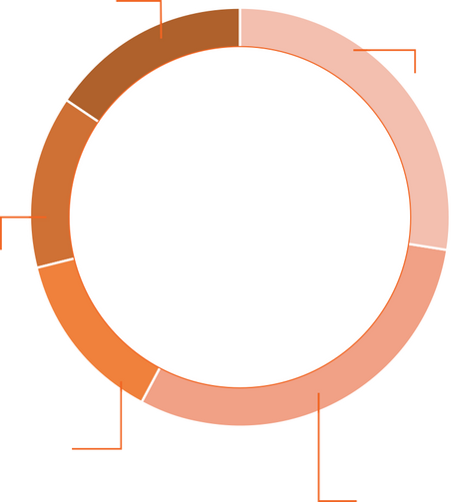
UM6P
IN NUMBERS
8756
Conventional Programs
Doctoral Programs
55%*
45
45%*
50%*
50%*
40*
130*
Male
Female
Male
Female
International exchange students
Academic Year 2025-2026
Nationalités
Programs
40*
45
10%*
130*
Total number of students
Nationalities
Programs
International Students
International Exchange Students
Business & Management
383
8,3%
Cultur.Ed
213
5,1%
Engineering course
771
16,7%
Predoc / PhD / Education Fellow
1343
28,4%
Prédoc / PhD / Education Fellow
1308
28,4%
YouCode
509
12,3%
Sciences Sociales, Economie & Humanités
953
20,6%
Architecture / Medical
Sciences
702
15,2%
Conventional Programs
Breakdown by cycle
Conventional Programs
Breakdown by cycle
Specific Programs
4 611
4 611
4145
Students
Students
Étudiants
Masters
434
9,4%
Bachelor / DUT
1396
30,3%
Health
543
11,8%
Science & Technologie
1337
3423
82,6%
1424
30,9%
(*) Conventional Programs
Notes:
To give you a sense of UM6P’s scale and diversity, let’s look at a few key figures from the current academic year. UM6P now counts around 8,700 students, representing 40 nationalities across 45 academic programs.
Gender balance is one of our strengths, with almost equal representation between men and women in both conventional and doctoral programs.
About 10% of our students are international, reflecting our growing global engagement.
Our programs are distributed across multiple fields — science and technology, social sciences, business, and health — with nearly one-third of students enrolled in engineering and applied sciences.
We also have over 4,000 students in specific programs such as 1337 and YouCode, which focus on digital skills and innovation.
These numbers illustrate UM6P’s rapid growth, diversity, and commitment to inclusive and future-oriented education.”

Slide 7

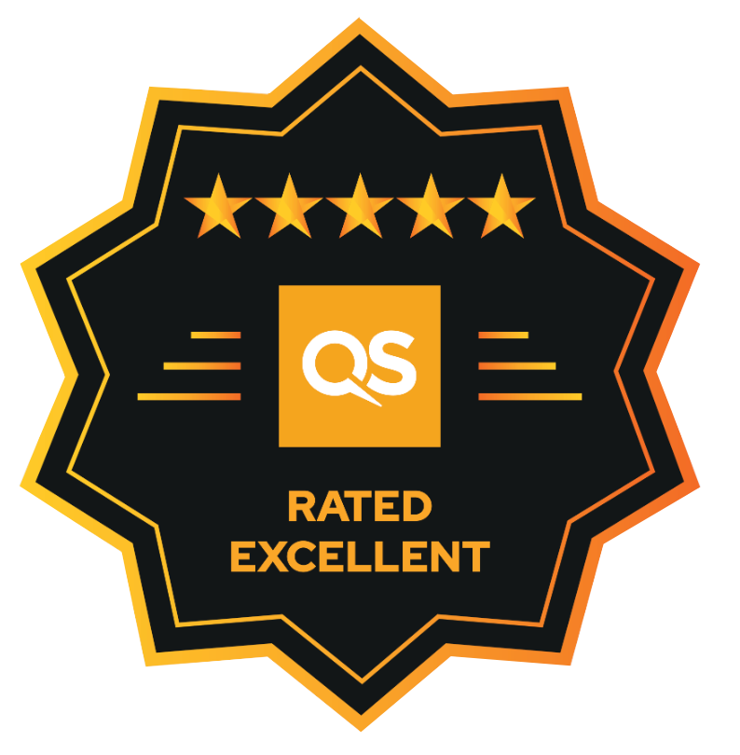
UM6P’s Latest Achievements in Global University Rankings
Times Higher Education World University Rankings (THE WUR) 2026
Ranked in the 351–400 Band globally in the second submission
1st in Morocco and North Africa
4th in Africa
Evaluated among 2,191 universities worldwide.
QS Stars Rating 2024
5 Stars Overall (Outstanding performance)
Recognized for achievements in Teaching, Employability, Research,
Facilities, Environmental Impact, and Global Engagement
Strengthening UM6P’s Global Reputation & Impact
These rankings highlight UM6P’s rapid progress as a world-class research and innovation hub,contributing to Africa’s academic excellence.
Notes:
UM6P has made remarkable progress in a very short time.
In the Times Higher Education World University Rankings 2026, we are ranked in the 351–400 band globally, just in our second participation.
We are proud to be ranked first in Morocco and North Africa, and fourth in Africa, among over 2,000 universities evaluated worldwide.

Slide 8
1. Academic Quality Office
Structure
Vision/Missions

Slide 9
AQ Office: Journey Since 2023
A young department, established in spring 2023; Team formation Summer 2024.
Dedicated to fostering a quality culture across education, research, and institutional services.
Several inititatives launched for accreditation and continuous improvement, aligned with international standards.
A strategic mission built on three pillars:
Innovation in quality assurance practices
Impact on learners, faculty, and institutional development
Excellence in quality processes and outcomes

Slide 10
Academic Quality Office
The mission of the Office of Academic Quality at UM6P is to provide support and guidance to faculty, staff, and students to ensure academic excellence and improve the overall Quality of Teaching and Learning at the University.
The Office have two core missions:
  Academic Quality Assurance
  Institutional Effectiveness

Slide 11
Organization Chart- Academic Quality Office
Academic Quality Office
Ali Bouabid
Academic Quality Assurance
Dounia SKALLI
Institutional Effectiveness
Meryem ALAMI KASRI
Learning
Outcomes
Program Reviews ​&​
Accreditations​
Data Collection & Analysis
Reporting

Slide 12
Missions of the AQ Office
The Academic Quality Assurance:
Has oversight on the learning outcomes assessments, review, and international accreditation of academic programs:
  ABET accreditation with CoC,
  ISO 21001 standards and UM6P Quality Assurance framework.
  …
The Institutional Effectiveness provides a variety of data-gathering, analysis, and reporting services directed at empirically supporting the evaluation of academic quality and evaluating the university’s administrative and service functions such as:
  Canvas Usage
  …

Slide 13
Quality Assurance Alignment
UM6P Vision, Mission & Goals
Institution Learning Outcomes (Core Competencies)
UM6P Teaching Units
Program Goals
Accreditation
Requirements,
Stakeholders
Program Educational Objectives
PEOs
Course Learning Outcomes
CLOs
Courses
Notes:
Cette pyramide illustre une logique d’alignement vertical (Institution > Programme > Cours) et horizontal (avec les exigences externes et internes), assurant la cohérence globale des parcours étudiants avec la mission de l’université et les standards de qualité internationaux.
alignement hiérarchique entre les différents niveaux d’objectifs d’apprentissage à l’UM6P, tout en assurant leur cohérence avec la vision institutionnelle et les exigences d’accréditation.
1. Institution Learning Outcomes (Core Competencies) – Niveau Institutionnel
Situés au sommet de la pyramide, ce sont les compétences fondamentales que l’UM6P attend de tous ses diplômés, quel que soit leur programme.
Alignés sur la vision, mission et les objectifs stratégiques de l’UM6P.
Influencés aussi par les exigences des agences d’accréditation.
Program Educational Objectives (PEOs) – Niveau Programme
Ce sont les objectifs à moyen terme (2–5 ans après l’obtention du diplôme), propres à chaque programme (ex : Computer Science).
Ils traduisent les attentes du monde professionnel, des employeurs, et de la société.
Les PEOs s’alignent à la fois sur les "Institution Learning Outcomes" et sur :
Les objectifs pédagogiques des unités d’enseignement
Les exigences d’accréditation (comme ABET, EUR-ACE, ANEAQ)
3. Course Learning Outcomes (CLOs) – Niveau Cours
Les CLOs décrivent ce qu’un étudiant doit être capable de faire à la fin d’un cours spécifique.
Ils sont directement alignés avec les PEOs, assurant ainsi que chaque cours contribue aux objectifs globaux du programme.
Ils traduisent également les standards attendus dans chaque discipline.

Slide 14
2. Academic Quality Office Initiatives
LMS Canvas
Student Course Evaluation (SCE)
Current Initiatives

Slide 15

About Canvas LMS
Canvas:
  Our learning management platform adopted at UM6P.
Our Role:
  Ensure monthly monitoring of the platform’s usage by faculty and students.
  Report monthly dashboards to top management and schools.
Our UM6P Partners :
  DSA
  CTE
  DEO

Slide 16

Overview of Student Course evaluation (SCE)
Tool to gather students’s feedback on courses and teaching
Conducted at the end of each semester
Ensures students’s voices are included in continuous improvement
Provides evidence for academic quality assurance and accreditation
Supports faculty development through constructive feedback
Results inform decision-making at course, program, and institutional levels.

Slide 17
3. Quality Assurance Ongoing Projects
  ABET
  ISO 21001
  AACSB
  EAQUALS
  ANEAQ
Notes:
To operationalize our QA strategy, we’ve launched key projects aligned with global benchmarks. Let me walk you through four major ones.”

Slide 18
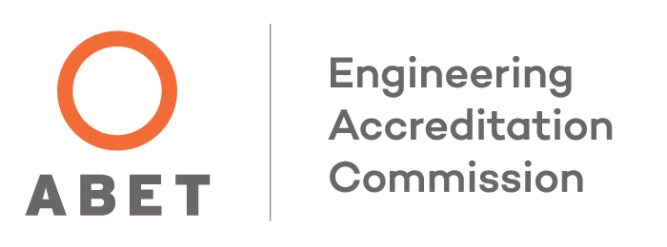
ABET Accreditation - A Strategic Lever for Engineering Programs
Objective: Gain international recognition for the quality of our Computer Science education.
Scope: Computer Science Program
Approach: Implementation of Outcome-Based Education, mapped to ABET criteria and centered on student learning and continuous improvement.
Notes:
We are pursuing ABET accreditation for our Computer Science program to align with international standards and boost recognition of our graduates.”

Slide 19
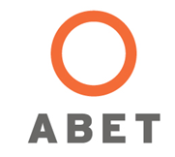
UM6P CS Program ABET Project Timeline
Need/Gap Analysis:
Fall 2024 - Spring 2025
Preparation Phase:
Spring 2025
Final Preparation:
Fall 2025
Assessment Cycle 2:
Spring 2027
Assessment Cycle 1:
Fall 2026
Pilot Assessment :
Spring 2026
Readiness Review:
Spring 2027
Request for Evaluation January 2028
Submission of the Self-Study
Report July 1, 2028

Slide 20

ISO 21001
An international standard for managing and improving the quality of educational services.
Applicable to:
Universities, schools, and training institutes
Continuing and executive education centers
Purpose:
Enhance learner experience, align practices with international standards, and strengthen educational impact
Notes:
ISO 21001 helps educational institutions improve learner experience, align with global standards, and structure their internal processes.”

Slide 21
ISO 21001 – Educational Organization Management System
Strategic Intention
Adopt an internationally recognized framework (ISO 21001) to structure our quality assurance efforts and promote a culture of excellence, inclusion, and continuous improvement.
Key Drivers Behind the Initiative
The need for a coherent, scalable quality system across the university
A focus on stakeholder engagement and learner satisfaction
Alignment with global educational standards
A foundation for future external recognition and certifications
Notes:
We’ve also adopted ISO 21001 — a management system for educational organizations — to build a scalable and coherent quality system across UM6P.”

Slide 22
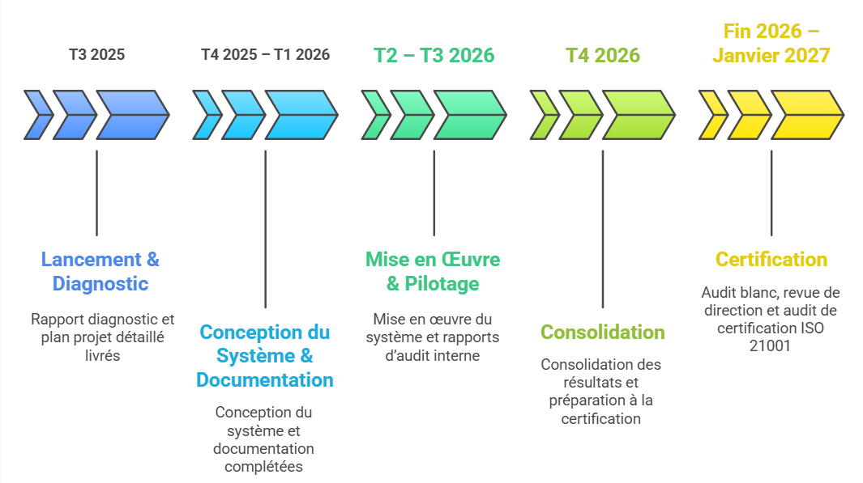
ISO 21001 Project Timeline

Slide 23

AACSB Certification – ABS
Strategic Purpose
Engage in the AACSB accreditation journey to align with global standards in business education, and foster a culture of excellence, impact, and innovation.
Focus Areas
Strategic management & mission alignment
Faculty qualifications & intellectual contributions
Learning outcomes assessment & continuous improvement
Societal impact & global engagement
Notes:
Our Business School has started the AACSB journey to align with excellence standards in business education. This enhances our global credibility and impact.”

Slide 24

EAQUALS Certification – Advancing Language Education Quality
Scope:
English Language Instruction & Academic Support
Objective:
Align the Language Center with European quality standards in language education
Framework: EAQUALS Quality Standards — covering:
  Curriculum design
  Learner support
  Staff development
  QA and evaluation processes
Notes:
We are working toward EAQUALS certification for our Language Center. It covers areas such as curriculum, staff development, learner support, and QA processes.”

Slide 25
4. UM6P Quality Assurance Framework : UM6P-QAF
Quality Assurance Landscape in Morocco - ANEAQ
UM6P-Quality Assurance Framework

Slide 26
ANEAQ - Quality Assurance Framework
ANEAQ Model – The 5 Key Domains:
Governance & Support Functions Management: Strategy, leadership, structures, resource management
Education & Training: Academic programs, pedagogy, student & program assessment, innovation
Scientific Research: Research strategy, coordination, outputs & partnerships
Student Support & Campus Life: Admissions, academic journey, student engagement, employability
Service to Society: Social & economic contributions at regional and national levels
Notes:
ANEAQ’s framework covers five domains: governance, education and training, research, student support and campus life, and service to society.”

Slide 27
UM6P - Quality Assurance Framework
Objective:
Harmonize quality assurance practices across all programs and schools
Provide a coherent institutional framework to ensure, manage, and continuously improve the quality of education and student services.
Structure:
Based on ANEAQ Model and Inspired by the ESG (European Standards and Guidelines), Organized according to the ADRI logic (Approach – Deployment – Results – Improvement)
Notes:
Our framework is inspired by European standards and organized using the ADRI logic: Approach, Deployment, Results, and Improvement. This ensures a continuous improvement cycle.”

Slide 28
UM6P- Quality Assurance Framework
The 8 Pillars of Quality Assurance Framework-UM6P
Policy &
Governance
Teaching &
Assessment
Learning
Support
Learning
Resources
Programs
Design
Student
Admission
Staff
Development
Continuous
Improvement
Notes:
These are the 8 pillars of our QA framework. They reflect our commitment to ensuring quality across programs, teaching, student services, and governance.”

Slide 29
Conclusion
UM6P QA Office
Foster
Quality
Culture
Quality
Assurance
QA Focal
Point
Support Programs and Departments
Notes:
At UM6P, a dedicated Academic Quality Office leads our QA efforts. Each school now has a QA focal point to promote ownership and coordination.”

Slide 30
MERCI
THANK YOU

